Slide 1
Graphite
Presentation by
Pam Moeai
March 4, 2016

Slide 2
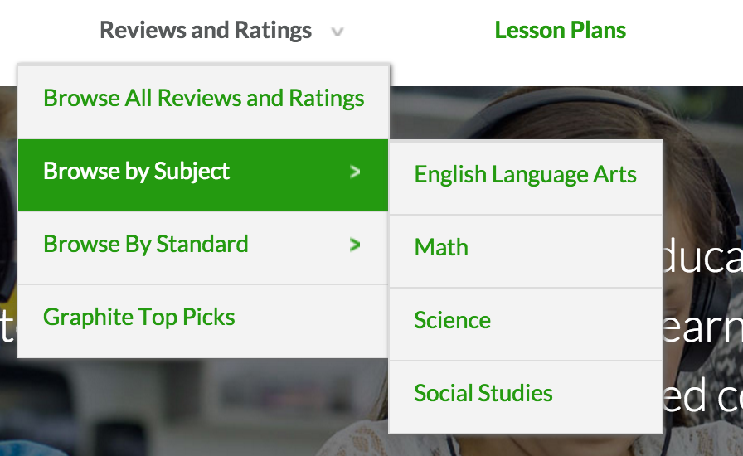
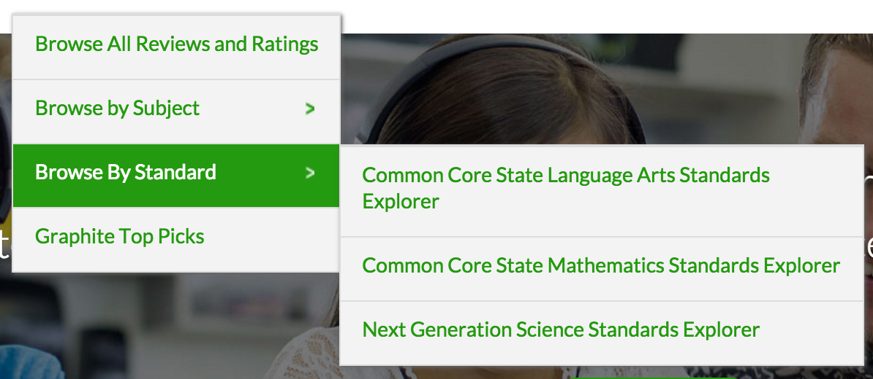
Reviews and Ratings

Slide 3
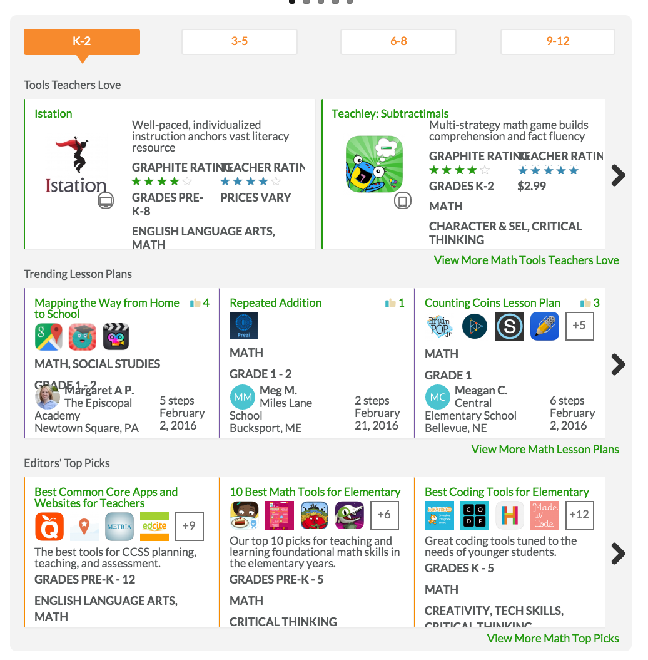
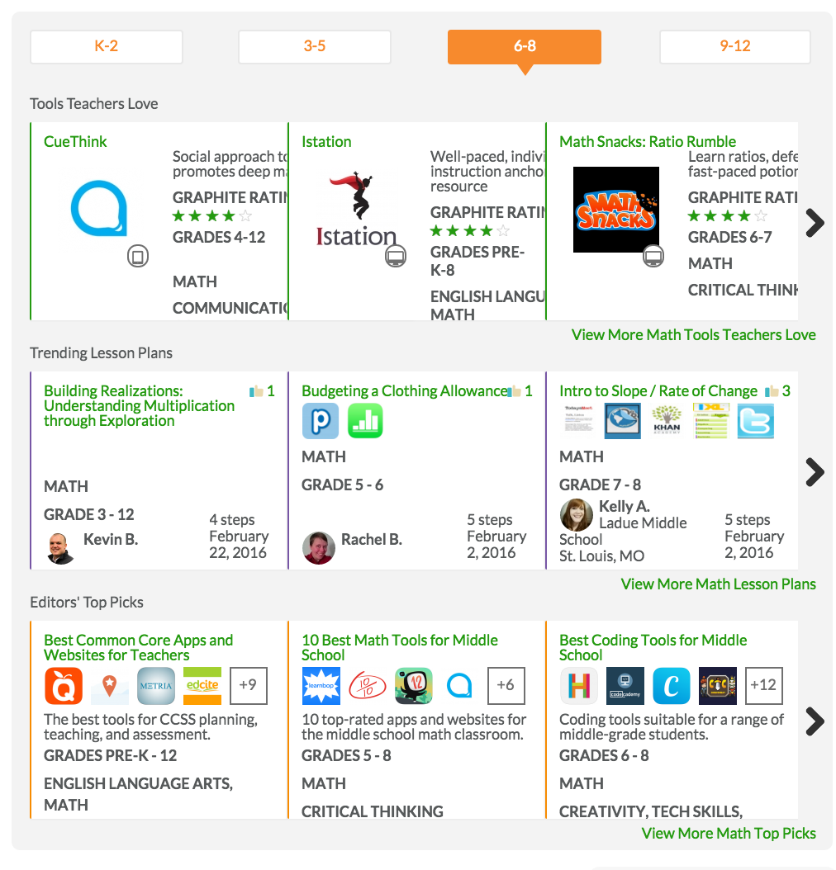
Reviews and Ratings

Slide 4
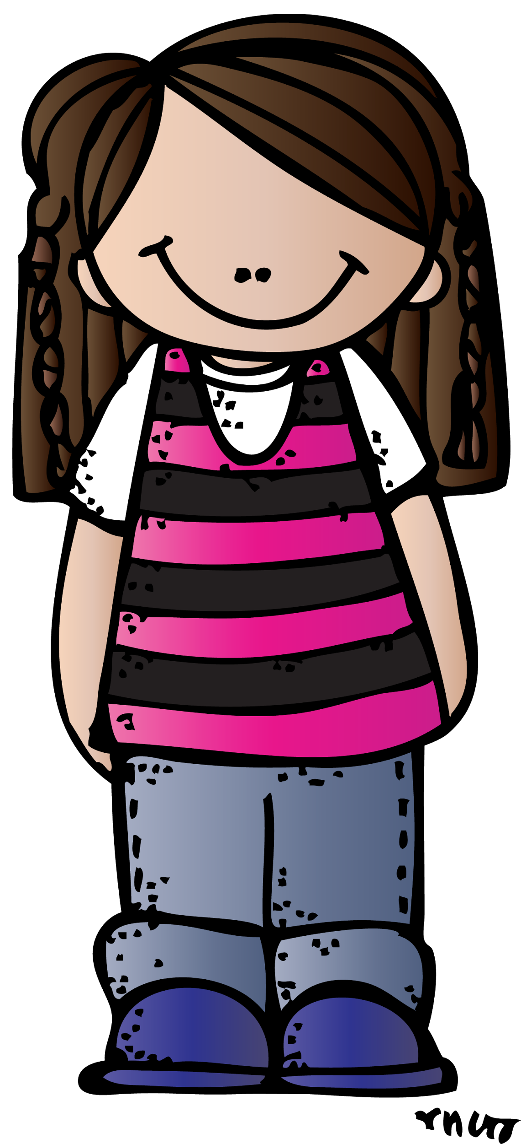
Lesson Plans

Slide 5
Lesson Plans

Slide 6
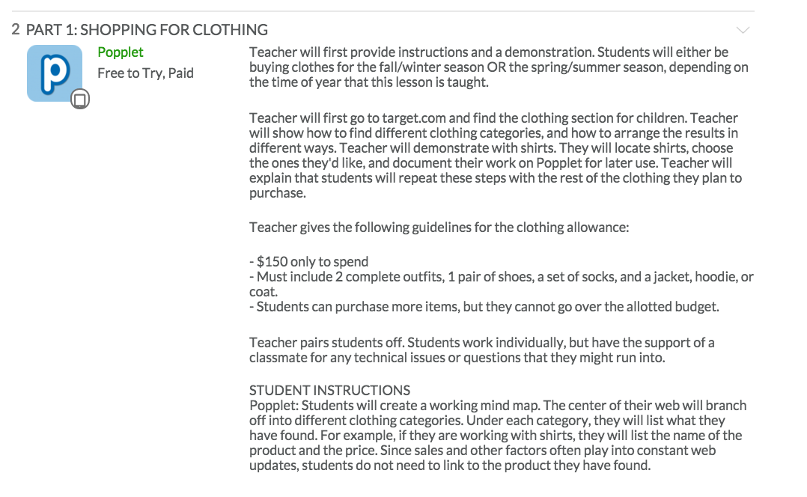
Lesson Plans

Slide 7
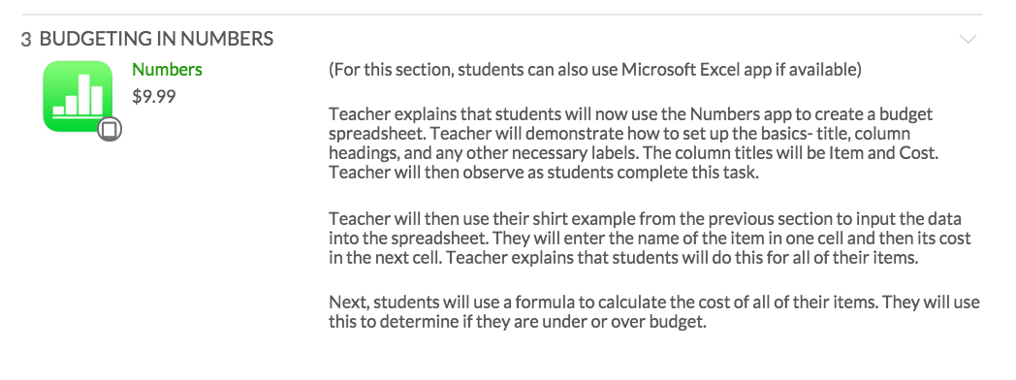
Lesson Plans

Slide 8
Lesson Plans

Slide 9
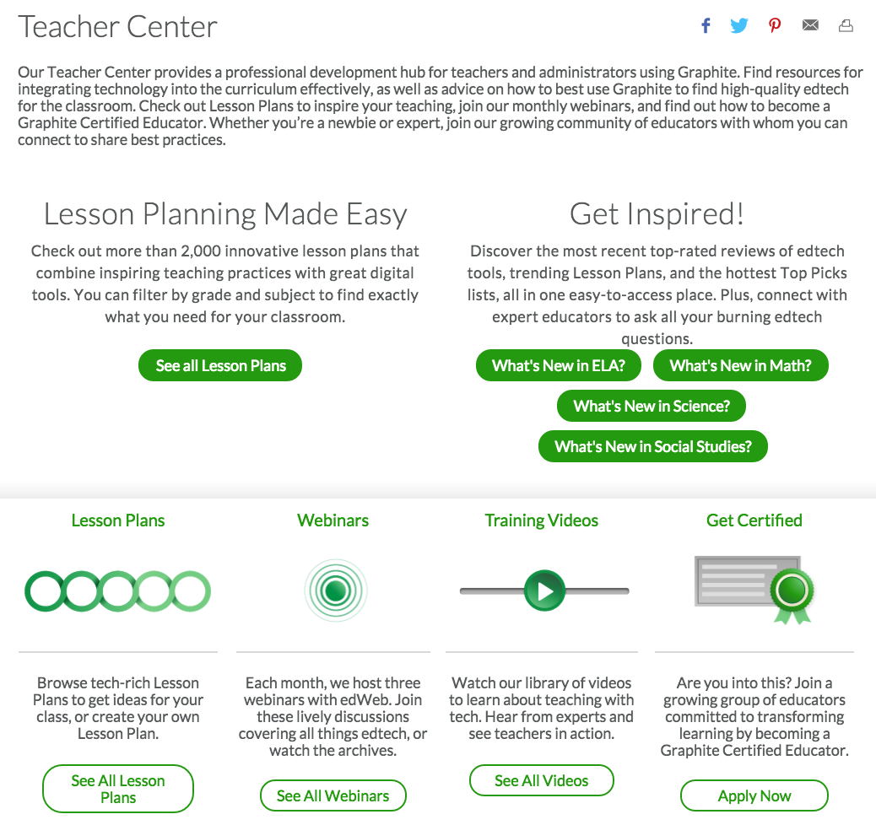
Teacher Center
*Lesson Plans
*What’s New? Get Inspired!
*Webinars
*Videos
*Professional Learning Community

Slide 10
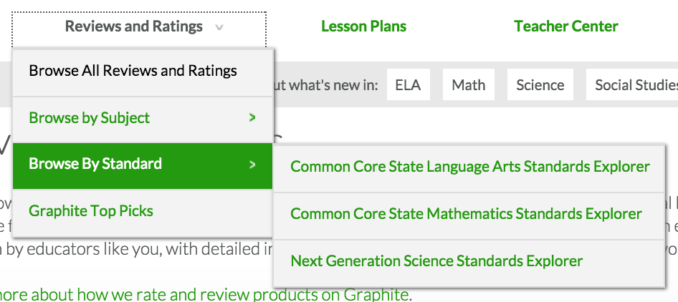
Common Core Connections!

Slide 11
Common Core Connections!

Slide 12
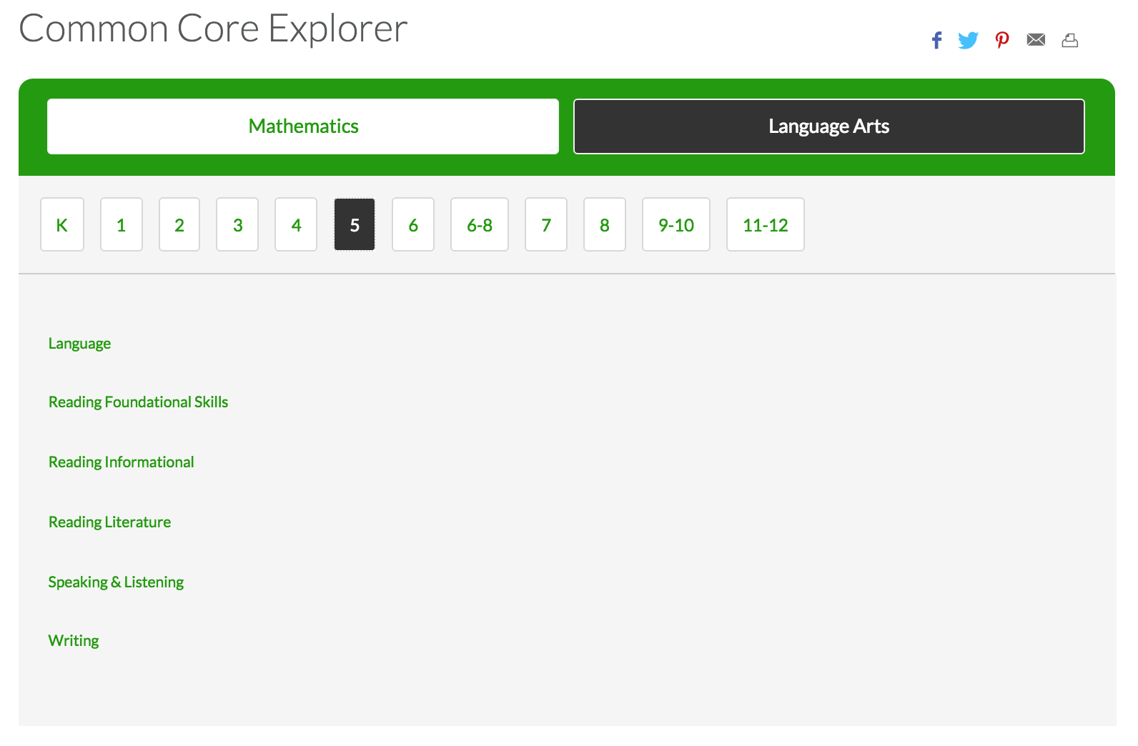
Common Core Connections!

Slide 13
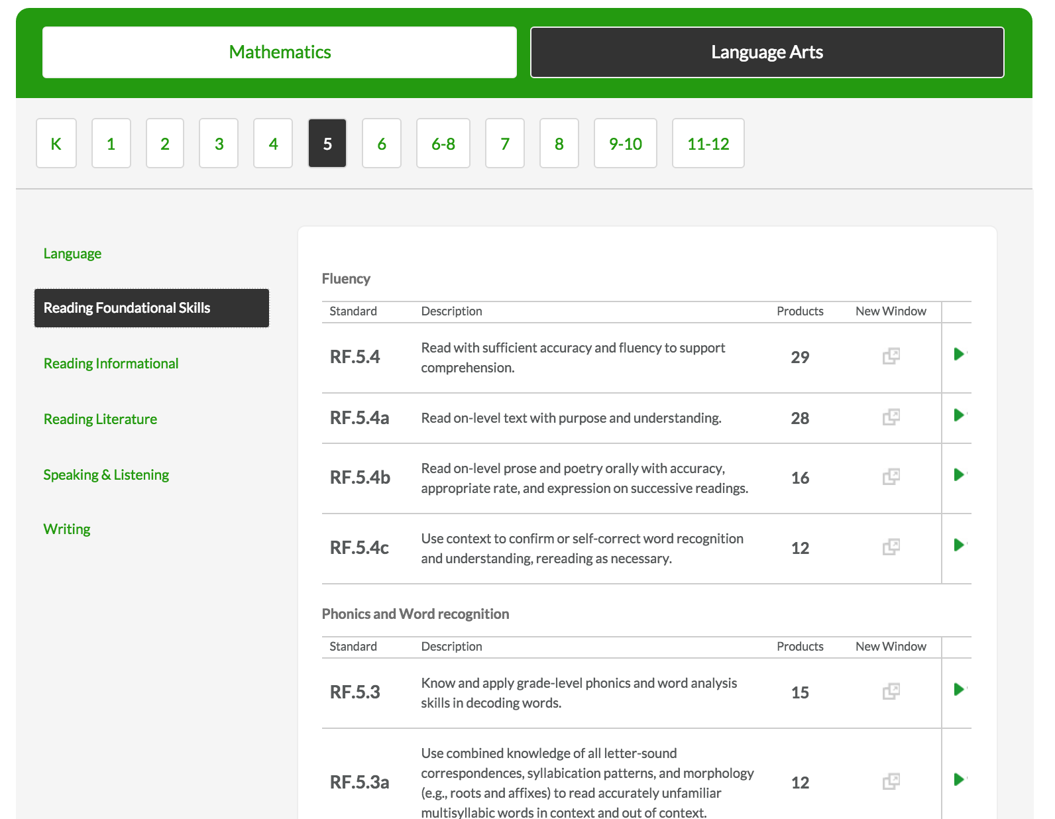
Common Core Connections!

Slide 14
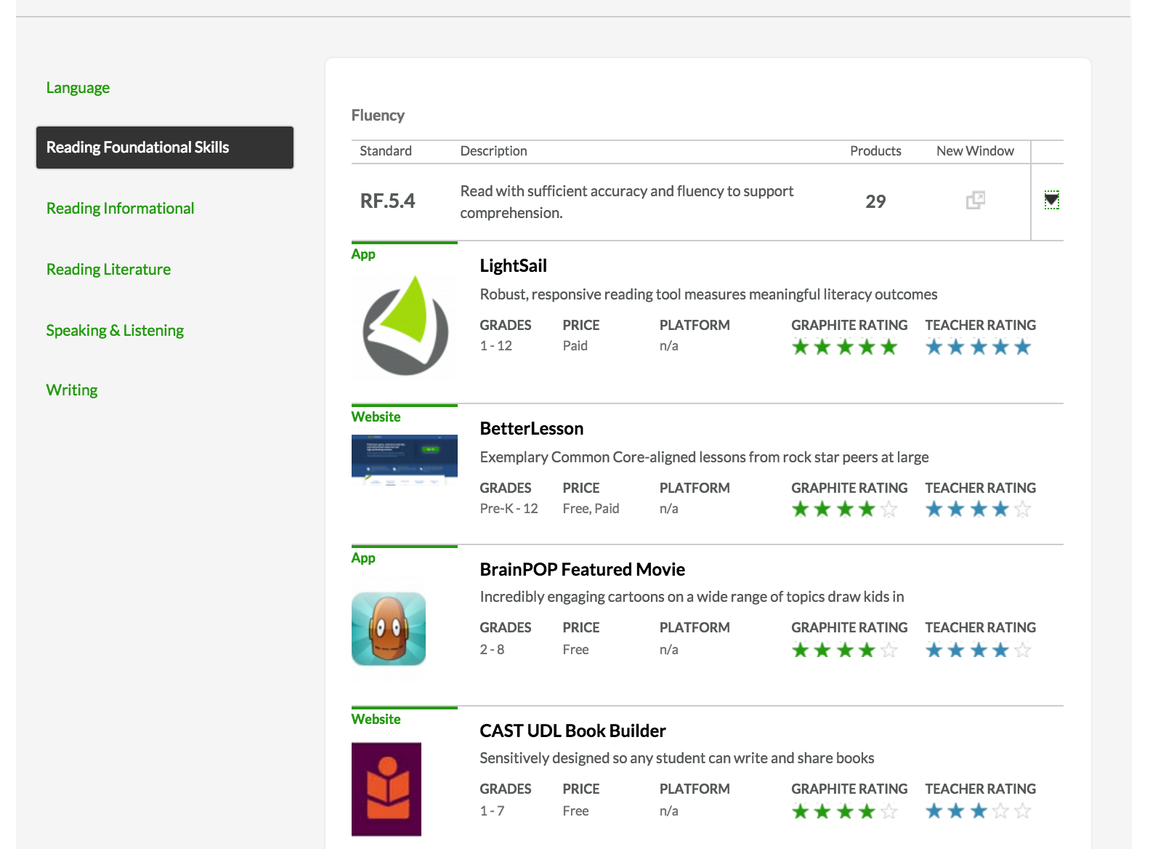
Common Core Connections!

Slide 15
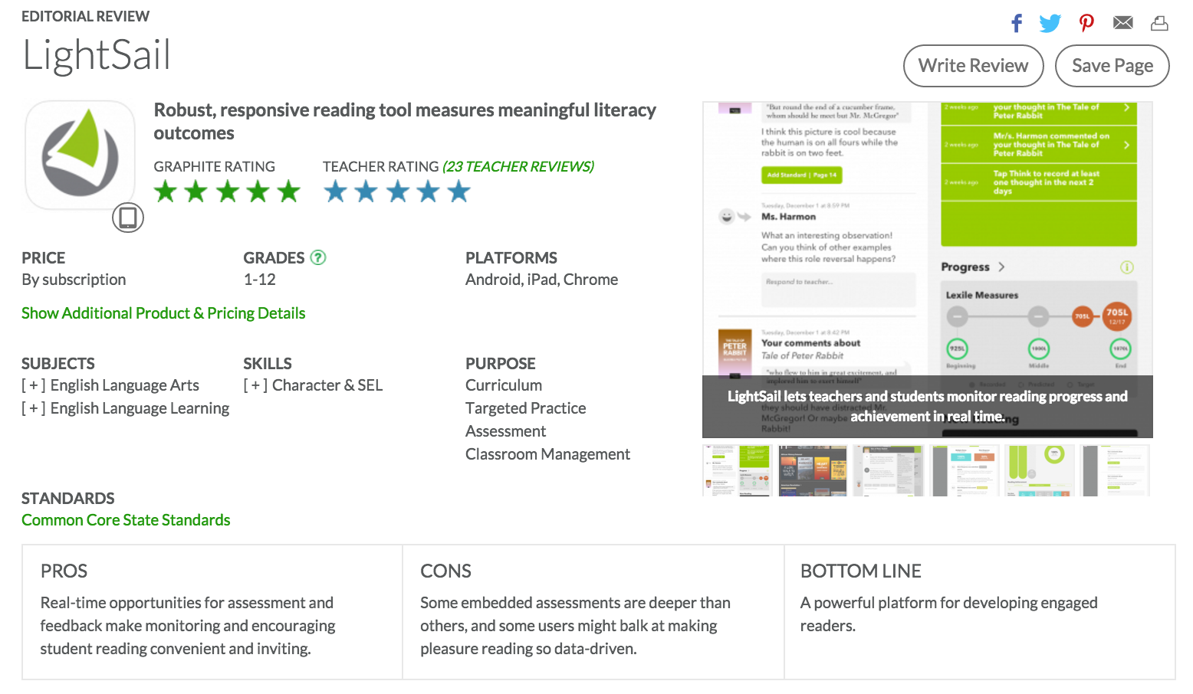
Common Core Connections!

Slide 16
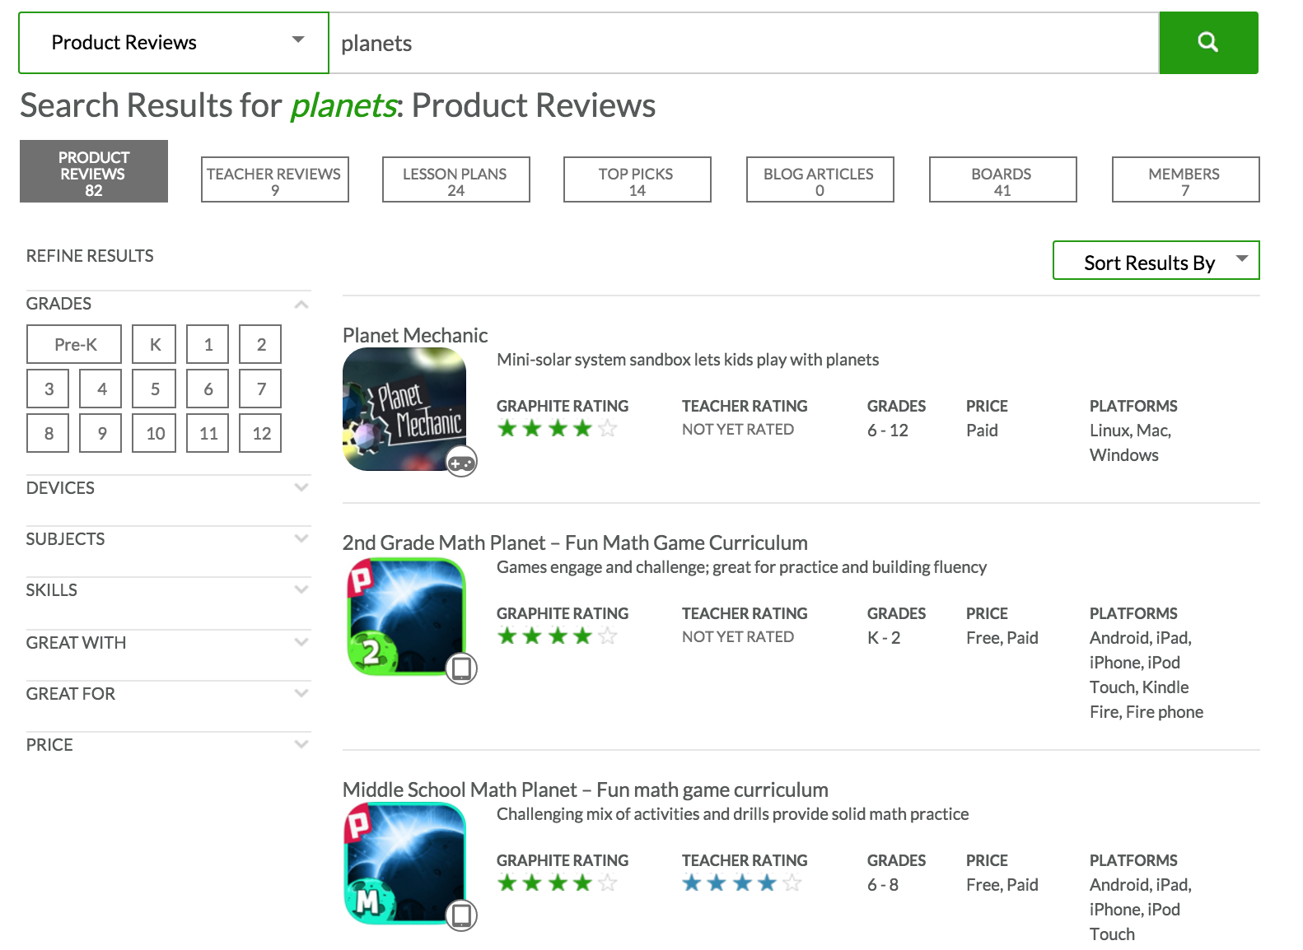
Easy Search Tool

Slide 17
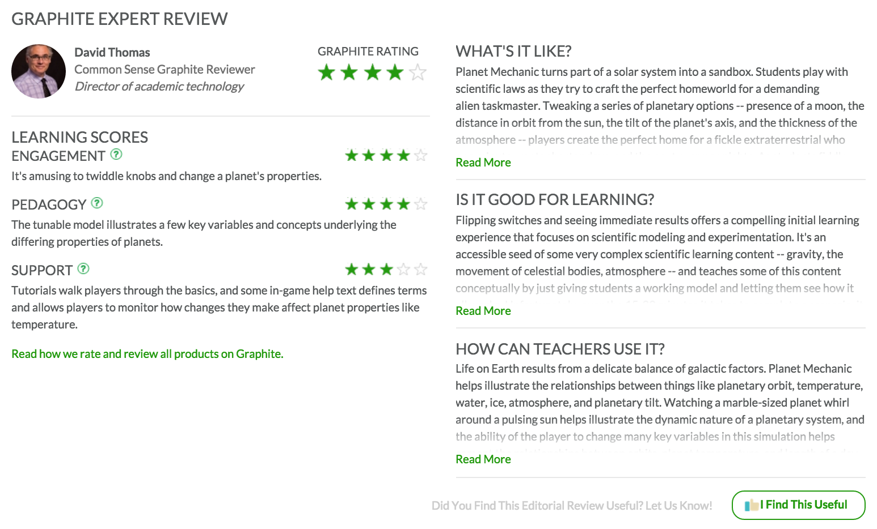
Expert Reviews

