Slide 1
Helpful Websites for Teachers
By Tom Redd
& Barbara Sanders

Slide 2
Microsoft Resources for Teachers
Legal location for software I will be demonstrating: http://www.educatornetwork.com/resources/tools
Several other great programs available for teachers at no cost
Access to the site is through your teacher microsoft login account
Check this site out for other useful programs. I use several of them regularly
(The Common Core Implementation Kite is a great program to try)
link

Slide 3
Add Music to your Classroom
Song Smith
https://www.dropbox.com/s/ueuspl1unq0rmy9/SongsmithSetup%20%28Academic%29.1.03.msi?dl=0
Great for review of any topic
Students create a simple song with a musical accompaniment
Repeated review of topic without realizing they are reviewing
Paid microsoft program but FREE for educators
link

Slide 4
Add Music to your Classroom
MuseScore
https://www.dropbox.com/s/9pod4zoip7a96zl/MuseScore-2.0.2.msi?dl=0
Subalius or Finale Want-to-be
Notate Music and listen to your creation
Students explore written music
Students write their own sheet music
Great for classroom accompaniment
Totally Free powerful music Program

Slide 5
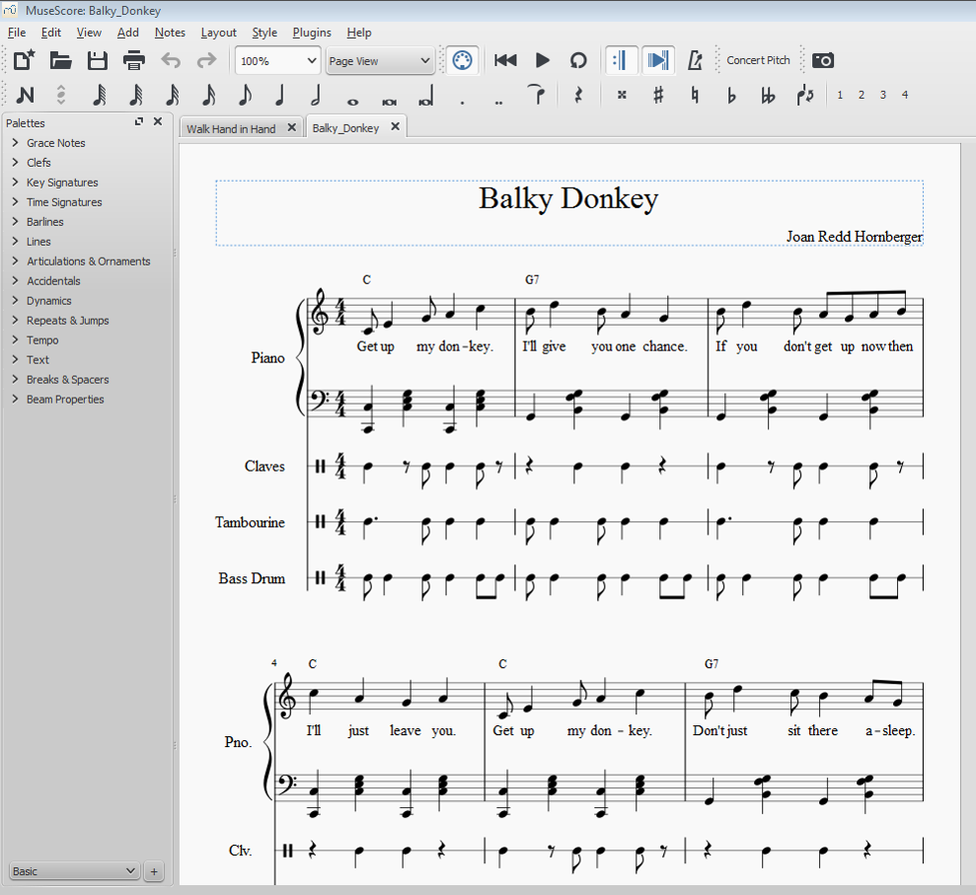

Slide 6
Add a Photo Collage to
your Presentations
https://www.dropbox.com/s/ci00hsjnoqt0kvw/MicrosoftAutoCollageAcademicSetup.msi?dl=0
Microsoft Autocollage 2008
Create an overview picture of a new topic
Create memory keepsake pictures
Simple and automatic
Free program

Slide 8
Need some behavioral interventions or ideas?
http://www.pbisworld.com/
Includes Tier 1 Tier 2 and Tier 3 Interventions
Also has downloadable data tracking forms

Slide 9
Need math practice ideas?
http://www.commoncoresheets.com/
Daily review creator
Create tests
Worksheets and answer sheets

Slide 10
K - 6 Lesson plans and Resources
http://www.k6edu.com/index.html
Lesson Plans
Graphic Organizers
Worksheets, writing pages, etc.
Downloads as a pdf file

Slide 11
Need a quick guide for cooperative-learning strategies?
https://sites.google.com/a/emints.org/cooperative-learning-strategies/
Quick reference guide for strategies

Slide 12
StoryCorps
https://storycorps.org/
Found in the Google Play Store: https://play.google.com/store/apps/details?id=com.bottlerocketapps.storycorps
Found in the App Store: https://itunes.apple.com/us/app/storycorps/id359071069?mt=8

Slide 13
StoryCorps App
https://storycorps.org/great-questions/#anyone
You could use the questions even if you do not use the app
You must be over 13 to use StoryCorps
With the app you can formulate questions and record the interview
You have the option of uploading it to Storycorps or not
Gives you a script on screen as you record the interview

Slide 14
One More Math Site
http://www.mathworksheetsland.com
Includes math worksheets
Guided lessons
Math posters

