Slide 2
JellybeanScoop.com
High interest, non-fiction articles

Slide 3
Innovative way to engage children in reading
Contemporary, HIGH interest articles
Perfect for closed reads!

Slide 4
Features:
Audio files
Comprehension
Vocabulary
Sentence building
Read aloud
Hundreds of articles
Fun Facts - Great story and conversation starters, not leveled
Leveled readings:
Starter
Single
Double
Triple
Correlated to Lexile
Updated frequently

Slide 5
Free
Designed for elementary and middle school students
Good demo videos
Tracks student progress

Slide 6
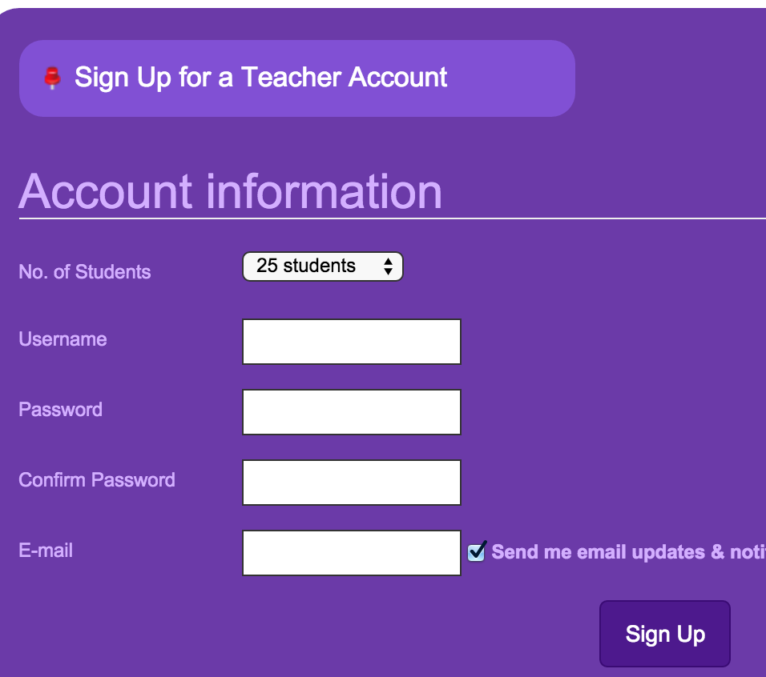
Teacher Account: Why?
Organize students by grade, level, group, etc
View test scores and answers
Tracks each students’ progress
Choose class size (25-100)

Slide 7
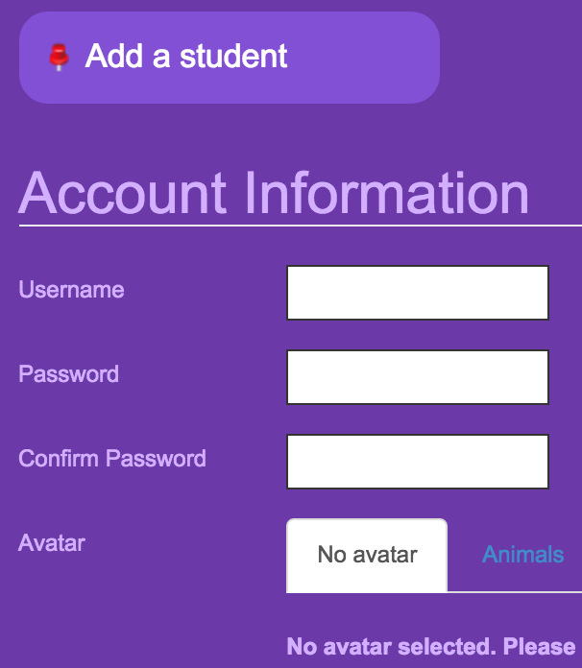
Student Accounts:
As a teacher, click on student name to see:
learning history - article read
test history - scores on all activities
books written in Jellybean Write
Students can see their own: learning and test history
**Teacher must set up student accounts individually. Username and password only. (no upload)

Slide 8
LenaB
123456

Slide 9
But WAIT!
There’s more!

Slide 10
Jellybean Writer
www.jellybeanscoop.com/autopub/

Slide 11
Jellybean Writer
Must sign in to save, print, download
Download pics from computer file
(collect pics and save in folder before starting book)
Download book to computer (unlimited)
Save to account - up to 10 books
Very easy to use
Many page layout templates to choose from
A lot or little text - your choice
Variety of fonts, size (Type text first)

Slide 12
Jellybean Games
www.jellybeanscoop.com/games/

Slide 13
Jellybean Games
Mathematical
Logical thinking
Language skills
Vocabulary
Geographic knowledge
World knowledge
Boost memory
Requires flash
Log in does not save scores
No log in needed to play

Slide 14
Gliches ?
When trying to sign up, teachers saw message that user name was already being used, but in reality, it took their username and created account.
When saving a Jellybean Book on my mac, it got stuck in never, never land.
Download worked great. Downloads as a PDF
Games are kind of addictive, but scores don’t save.
Not sure which browser works best.

Slide 15
Extra Share:
checklist for teacher about new students
Teacher: Student Name
Student Number
Your new student has been added to: Successmaker
Imagine Learning
Educator’s Handbook
Remember to add student to Gradebook concepts, ST Math (triple click), Go Math ….

