Slide 1
ZAPTION!
A Brief overlook

Slide 2
ZAPTION: A Tool for creating video-based quizzes
Similar to EdPuzzle – no voice narration
A little bit like Kahoot – interactive assessments
Basic (Free) & Pro ($89/year) Also K-12 Site License – Comparison Chart
Uses Video from any source – YouTube, Vimeo, Zaption library, your own…
Drag & Drop to edit
”Share” for individual viewing or ”Present”
Zaption Presenter – adds interactivity (is that a word?) More later…
Great Help menu and videos

Slide 3
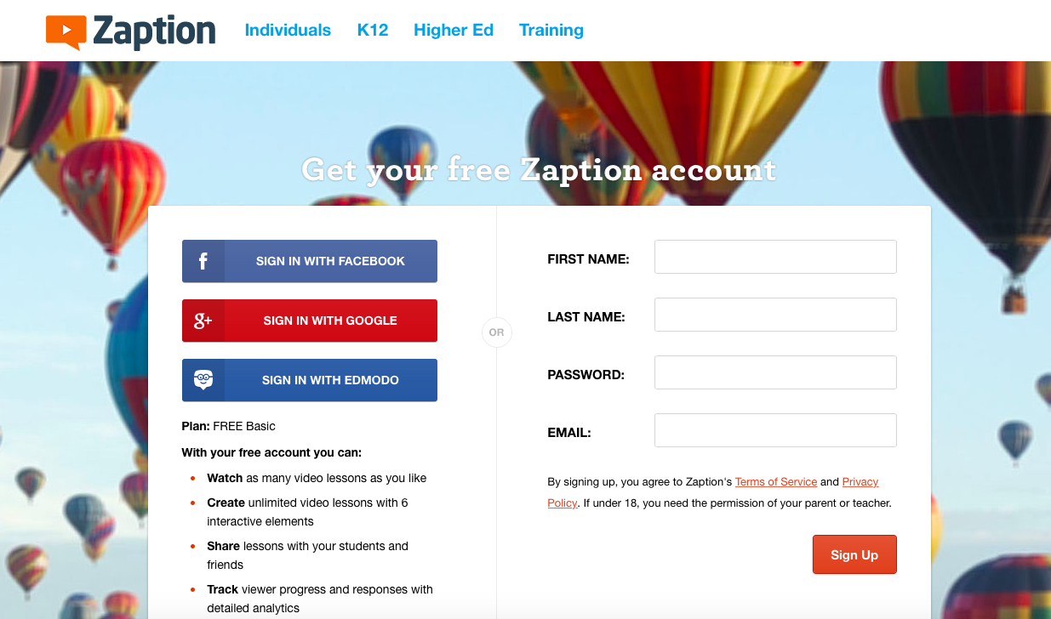
Let’s get started
Sign-up Page
Students do NOT need to sign-up to participate in Zaption Presenter

Slide 4
vocabulary
Tour – Old Term for interactive video Lesson
Copy Collection = Copy Tour
Any lesson (tour) can be copied.
Copied Lessons appear on My Lessons

Slide 5
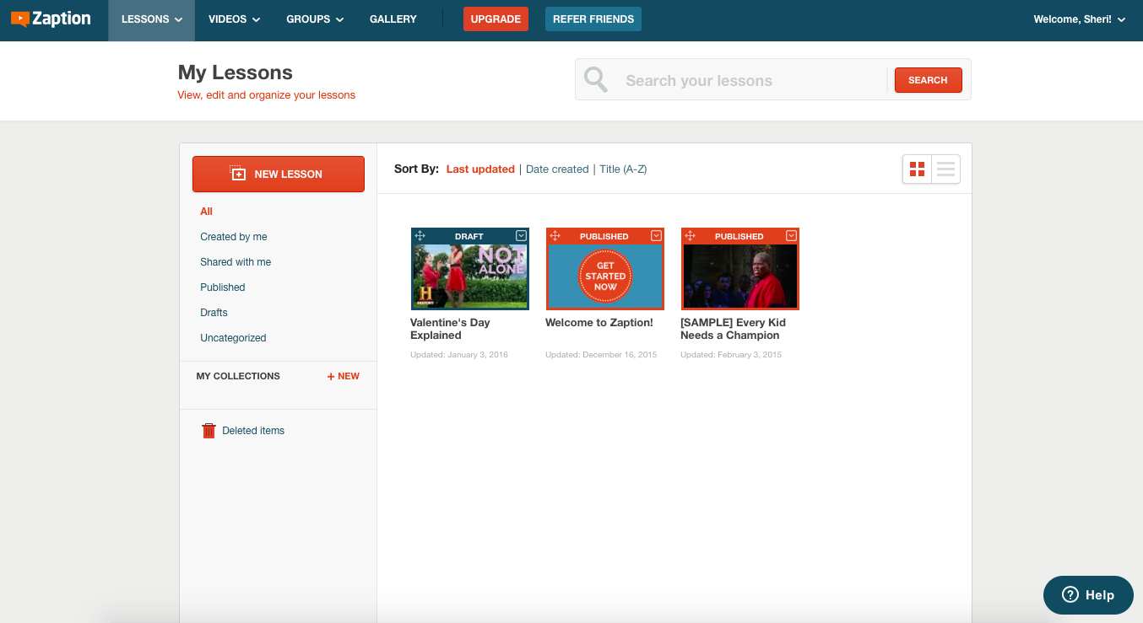
Basic Interface

Slide 6
Editing Interface
My Zaption Account
Notes:
On your account show the basic editing – drag & drop, elements
Point out options available with Pro version – multiple videos, more types of questions

Slide 7
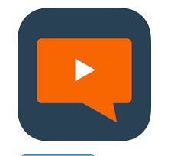
Zaption presentor
Lets you present a video in the front of the room and or stream it to your students' devices – computers or mobile devices. (No Android app yet but can be played on a Chrome browser)
Your students will be able to use Zaption Presenter to ask questions directly from their devices while the video plays.
Teachers can add questions to the presentations on the fly and have those questions appear on students' devices.
Teachers can use the pointer or drawing tool to call attention to items on the screen.

Slide 8
Let’s take a closer look…
My Zaption Account

